Slide 1
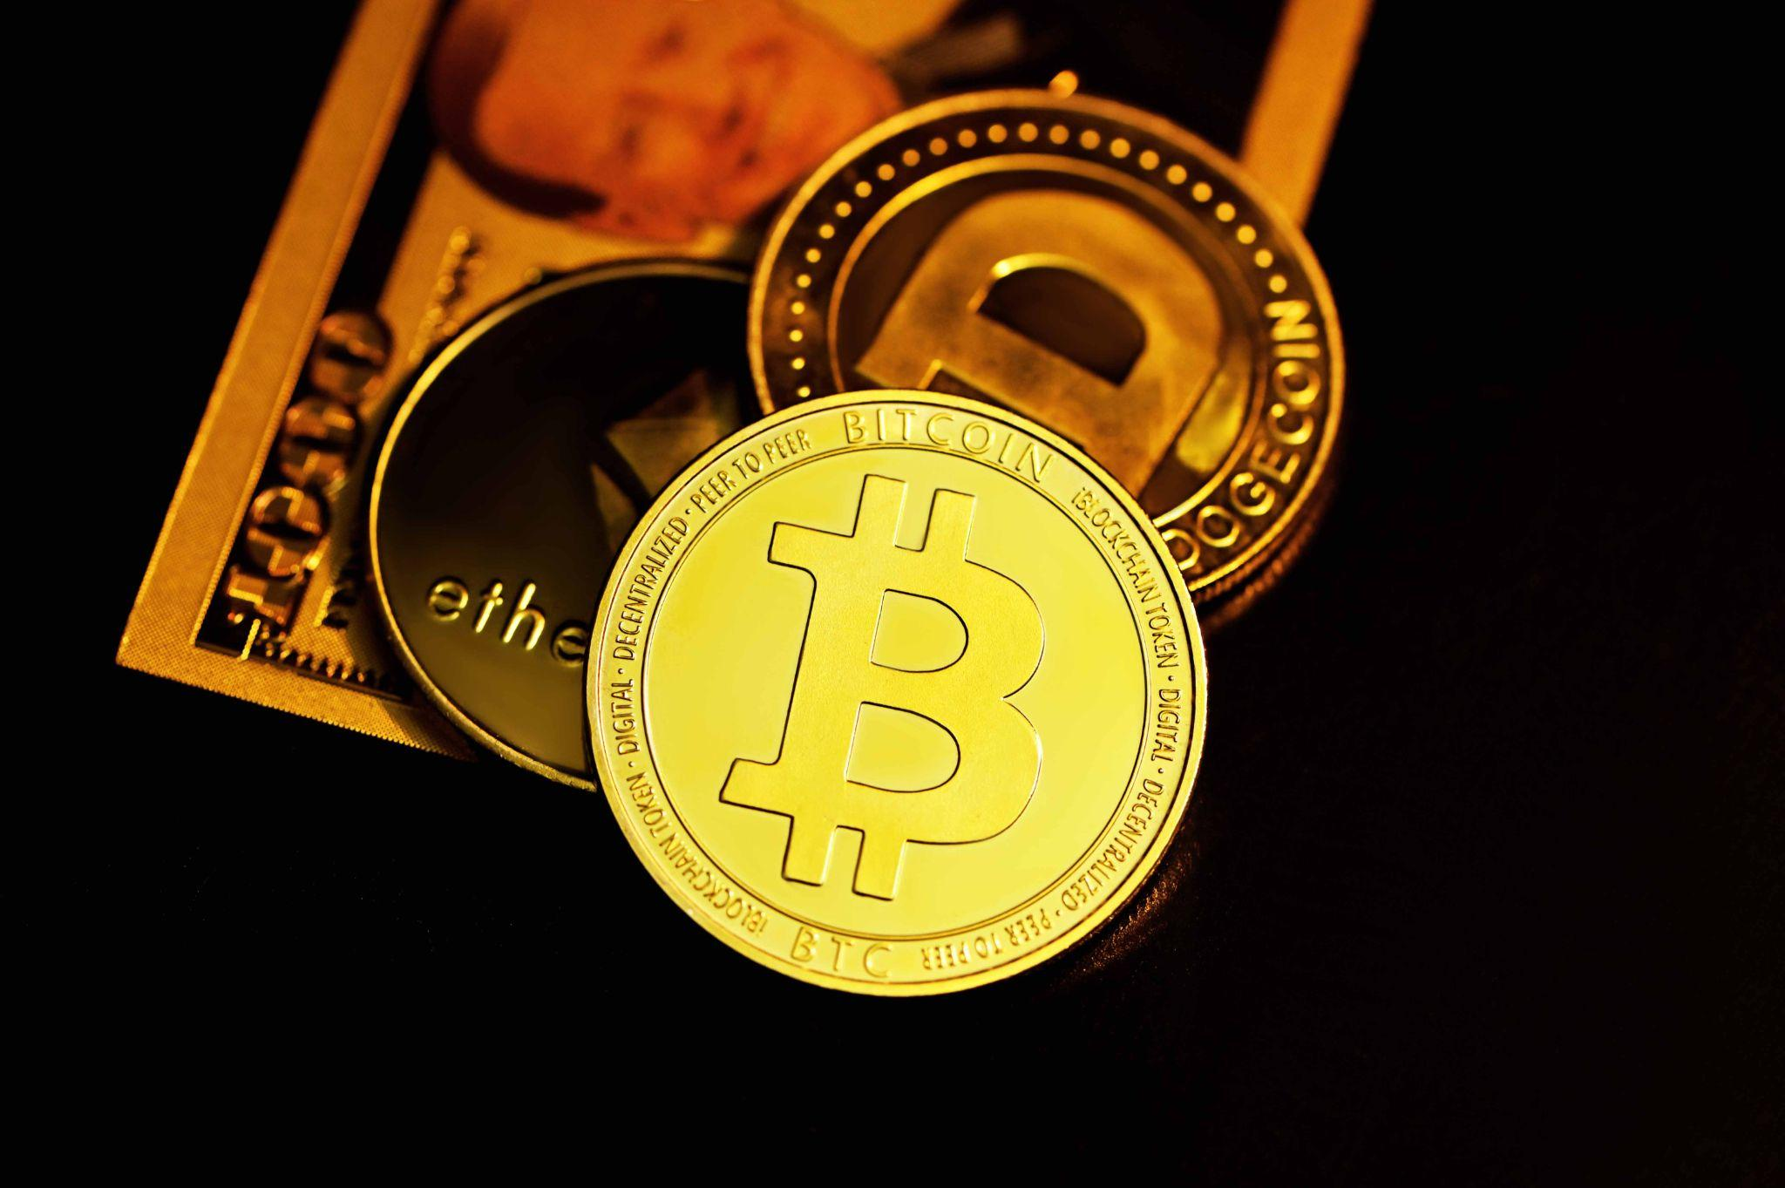
Global Crypto Behavior Index

Slide 2
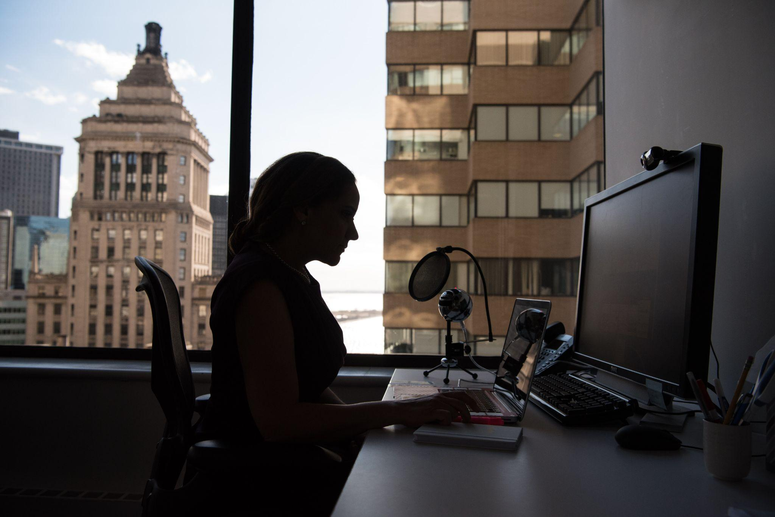

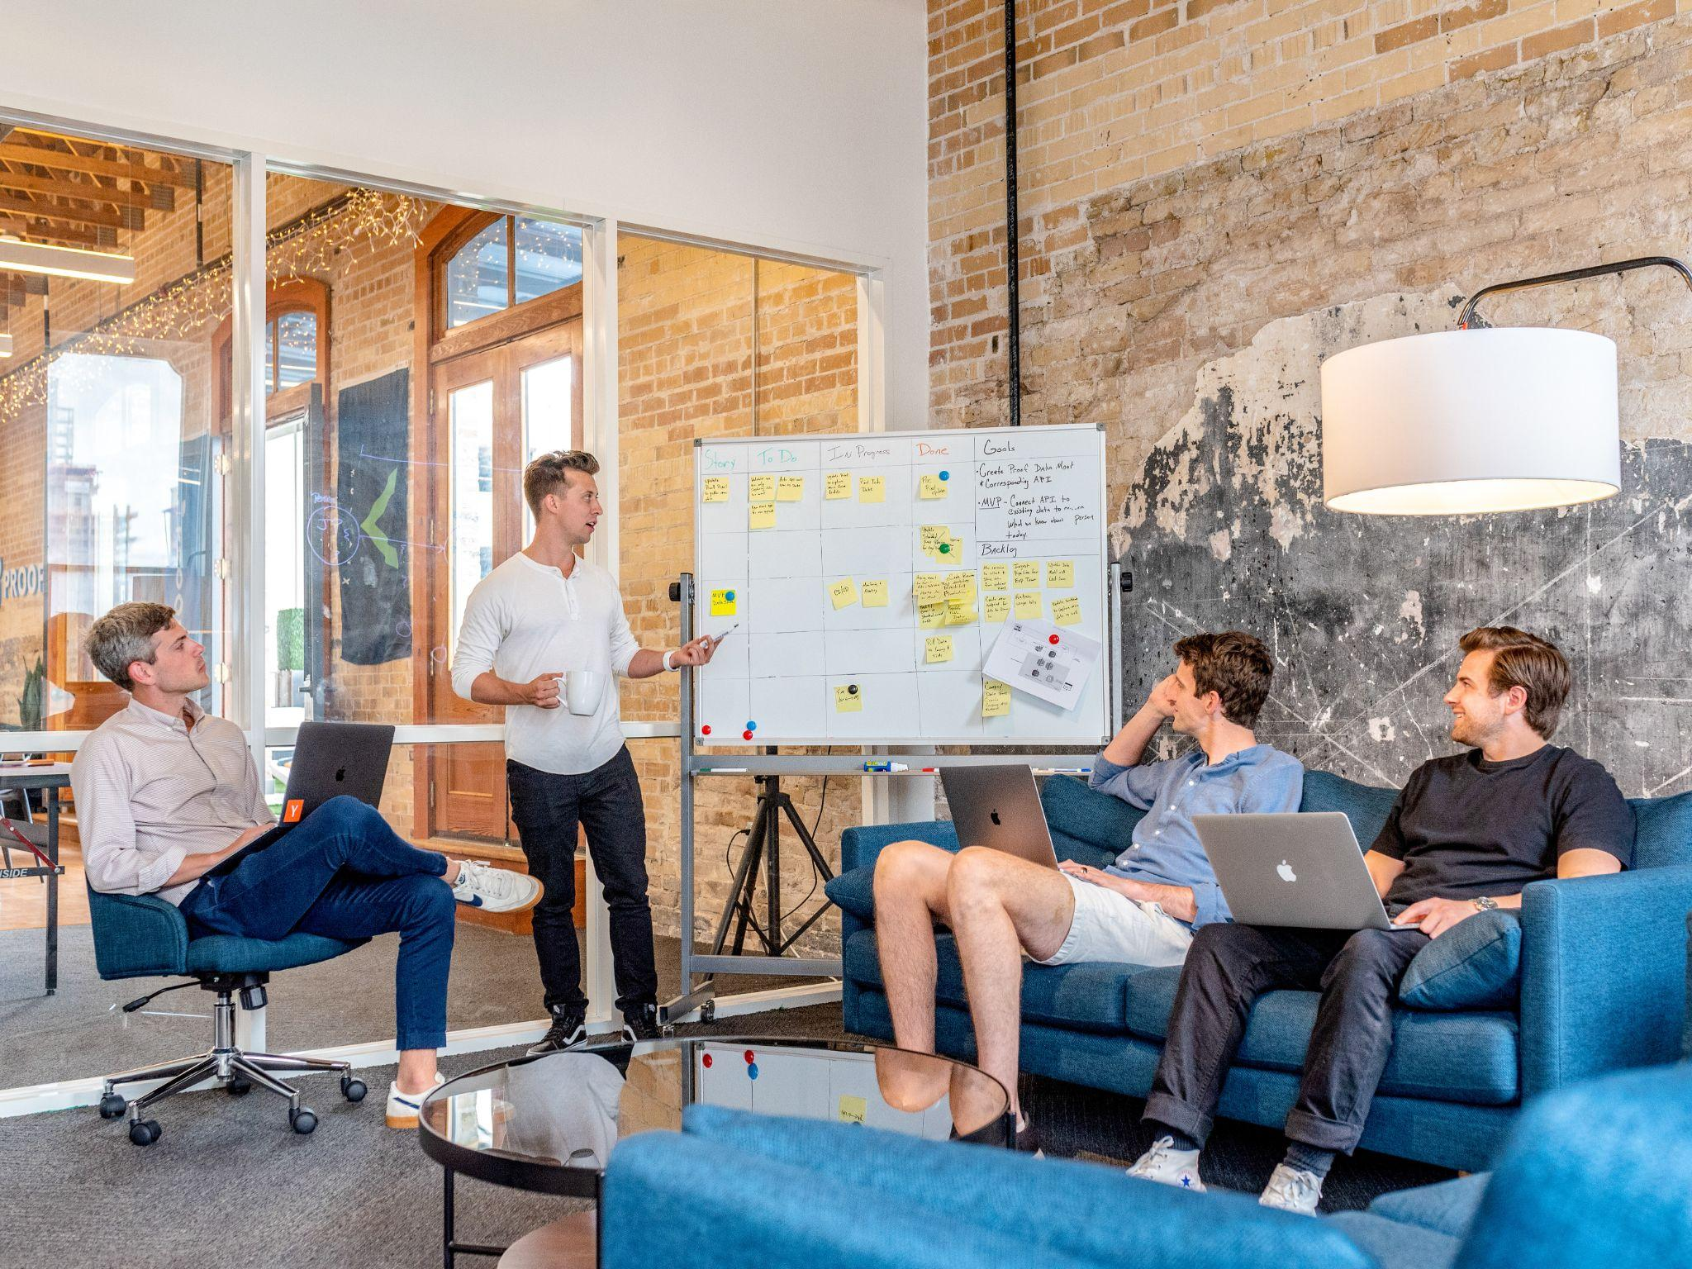
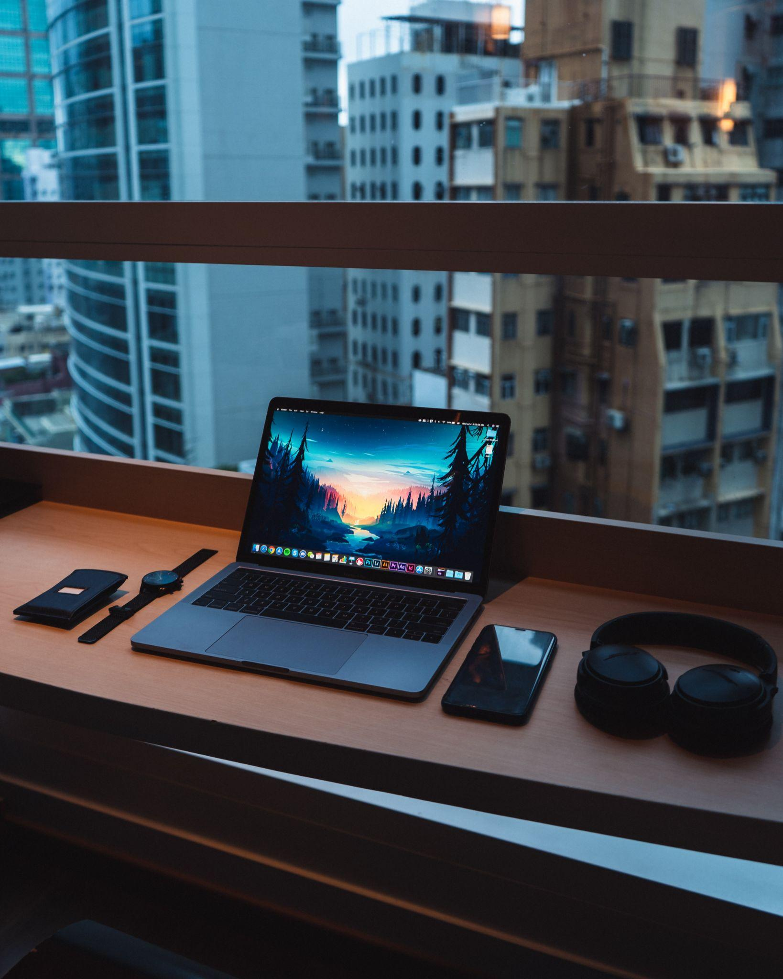
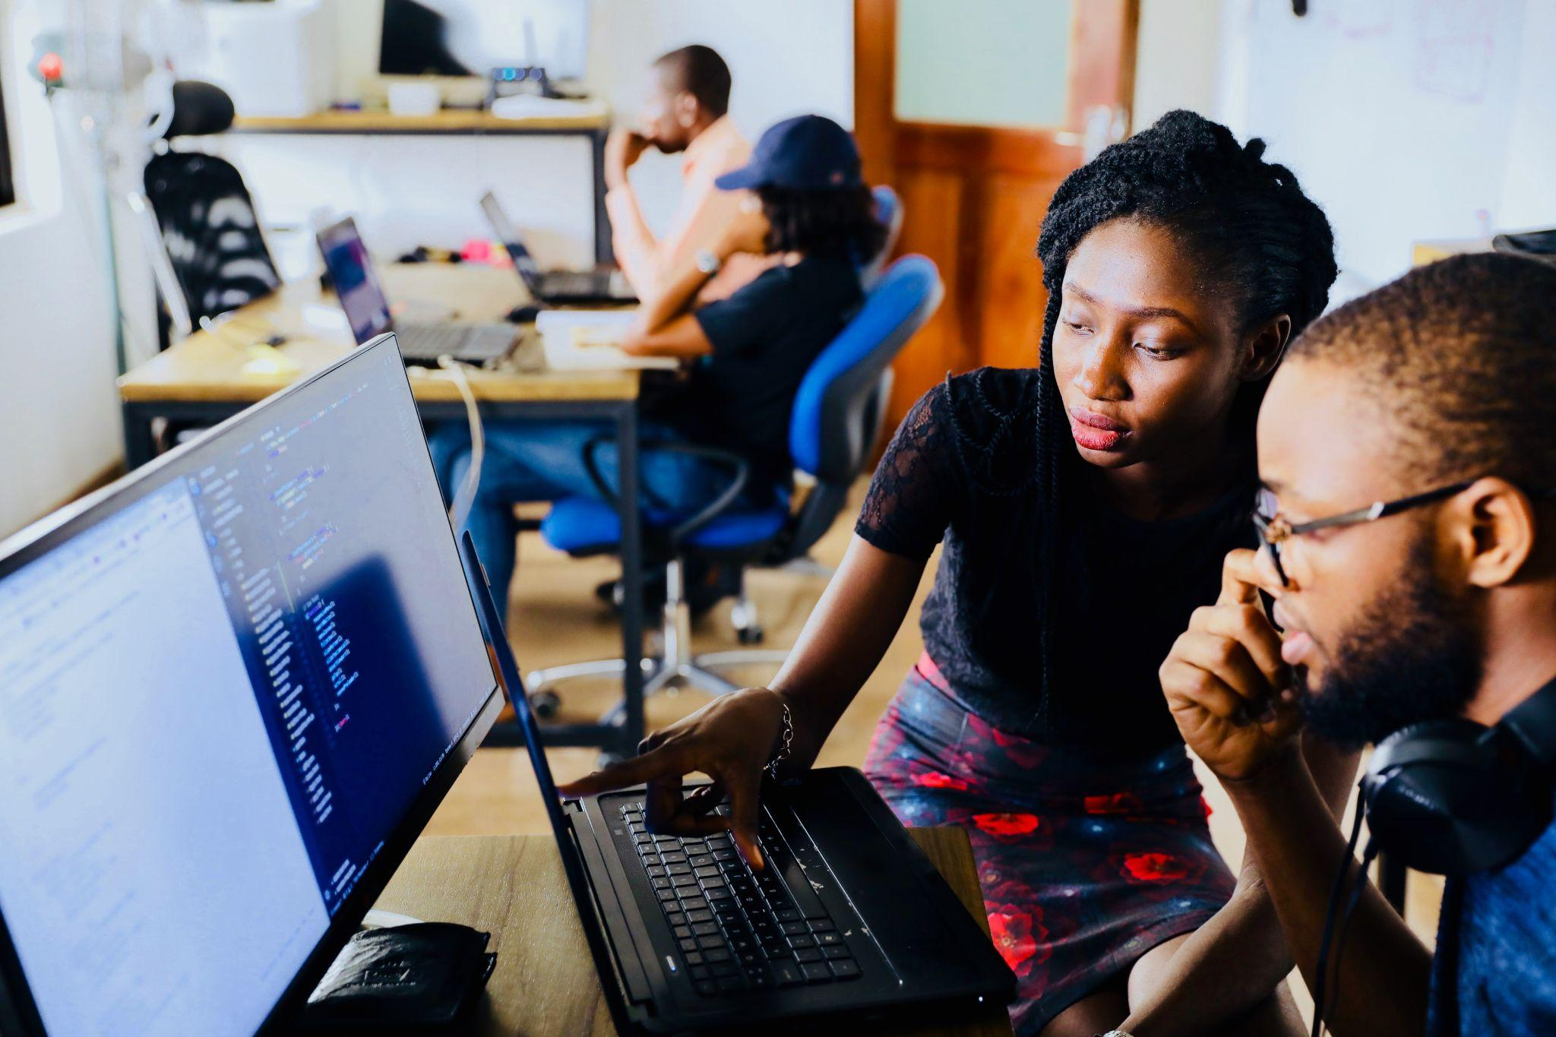
Meet the Team
Project Lead Jason Garcia
Visionary
Christian Tayrien
Lead Frontend Engineer Nansamba Ssensalo
Project Coordinator Will Olesinski
Lead Backend Engineer Daniel de Leon

Slide 3
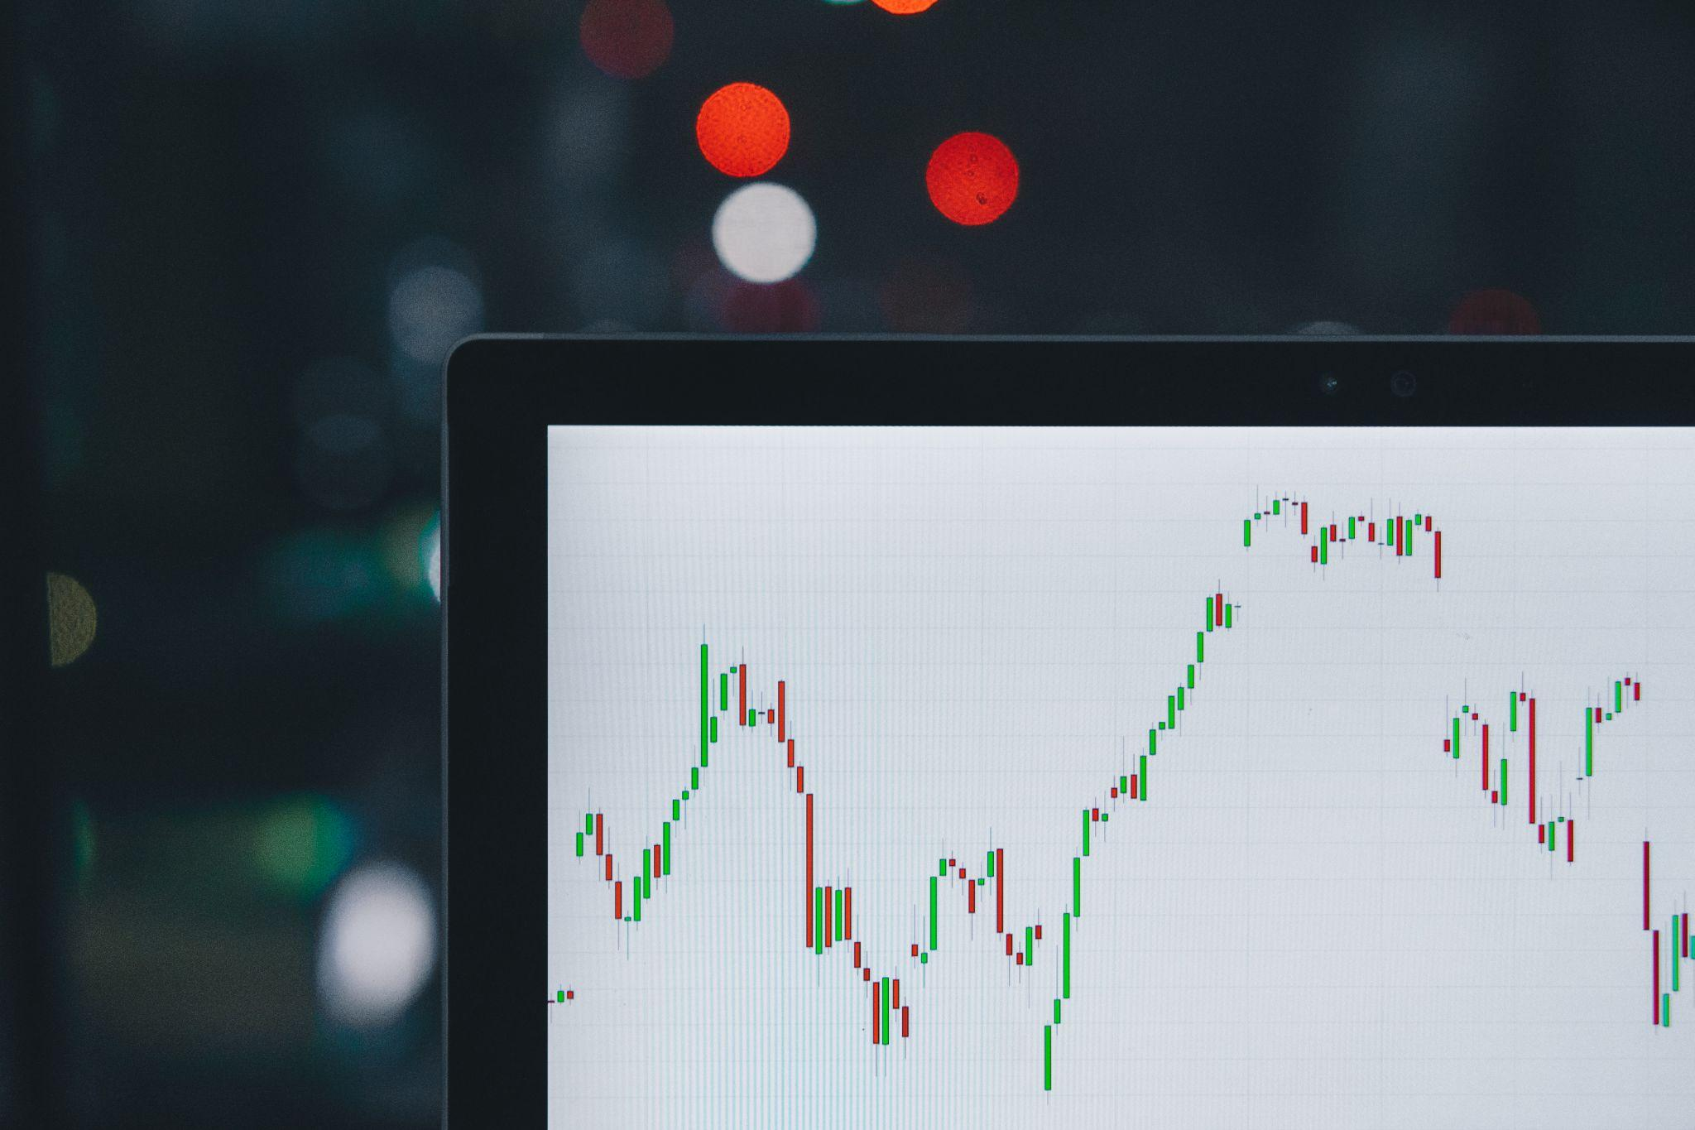
GCB Index
Project Objective:
Understand the effects of news occurrences and other market influences on the price and volume of several cryptocurrencies.
High Media Coverage | Positive Sentiment | % Change in Price
Inflation | Negative Sentiment | % Change in Price

Slide 4
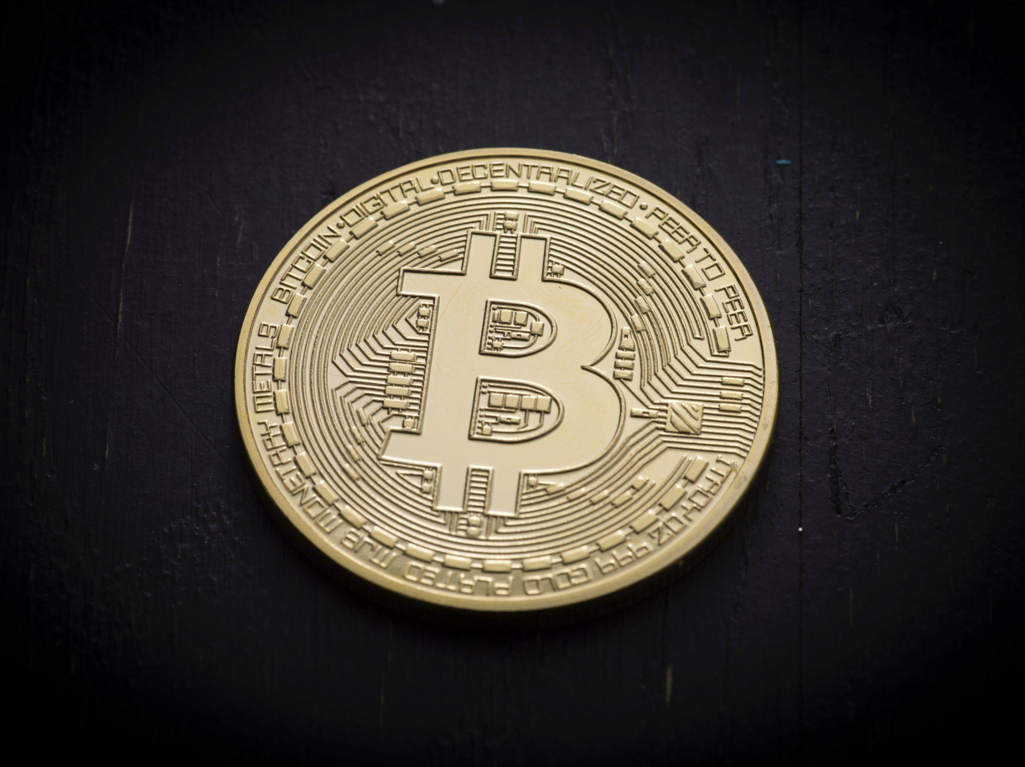
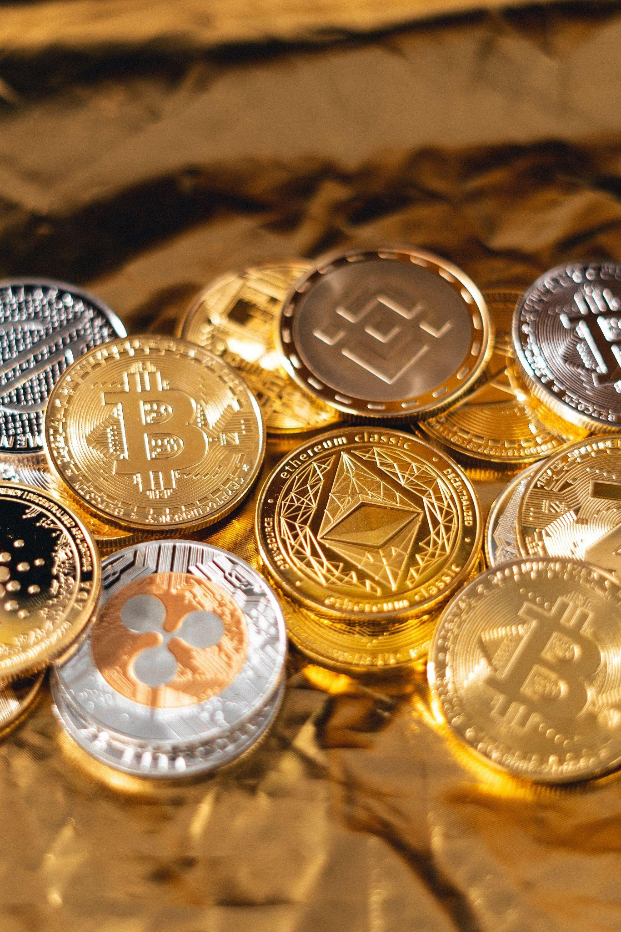
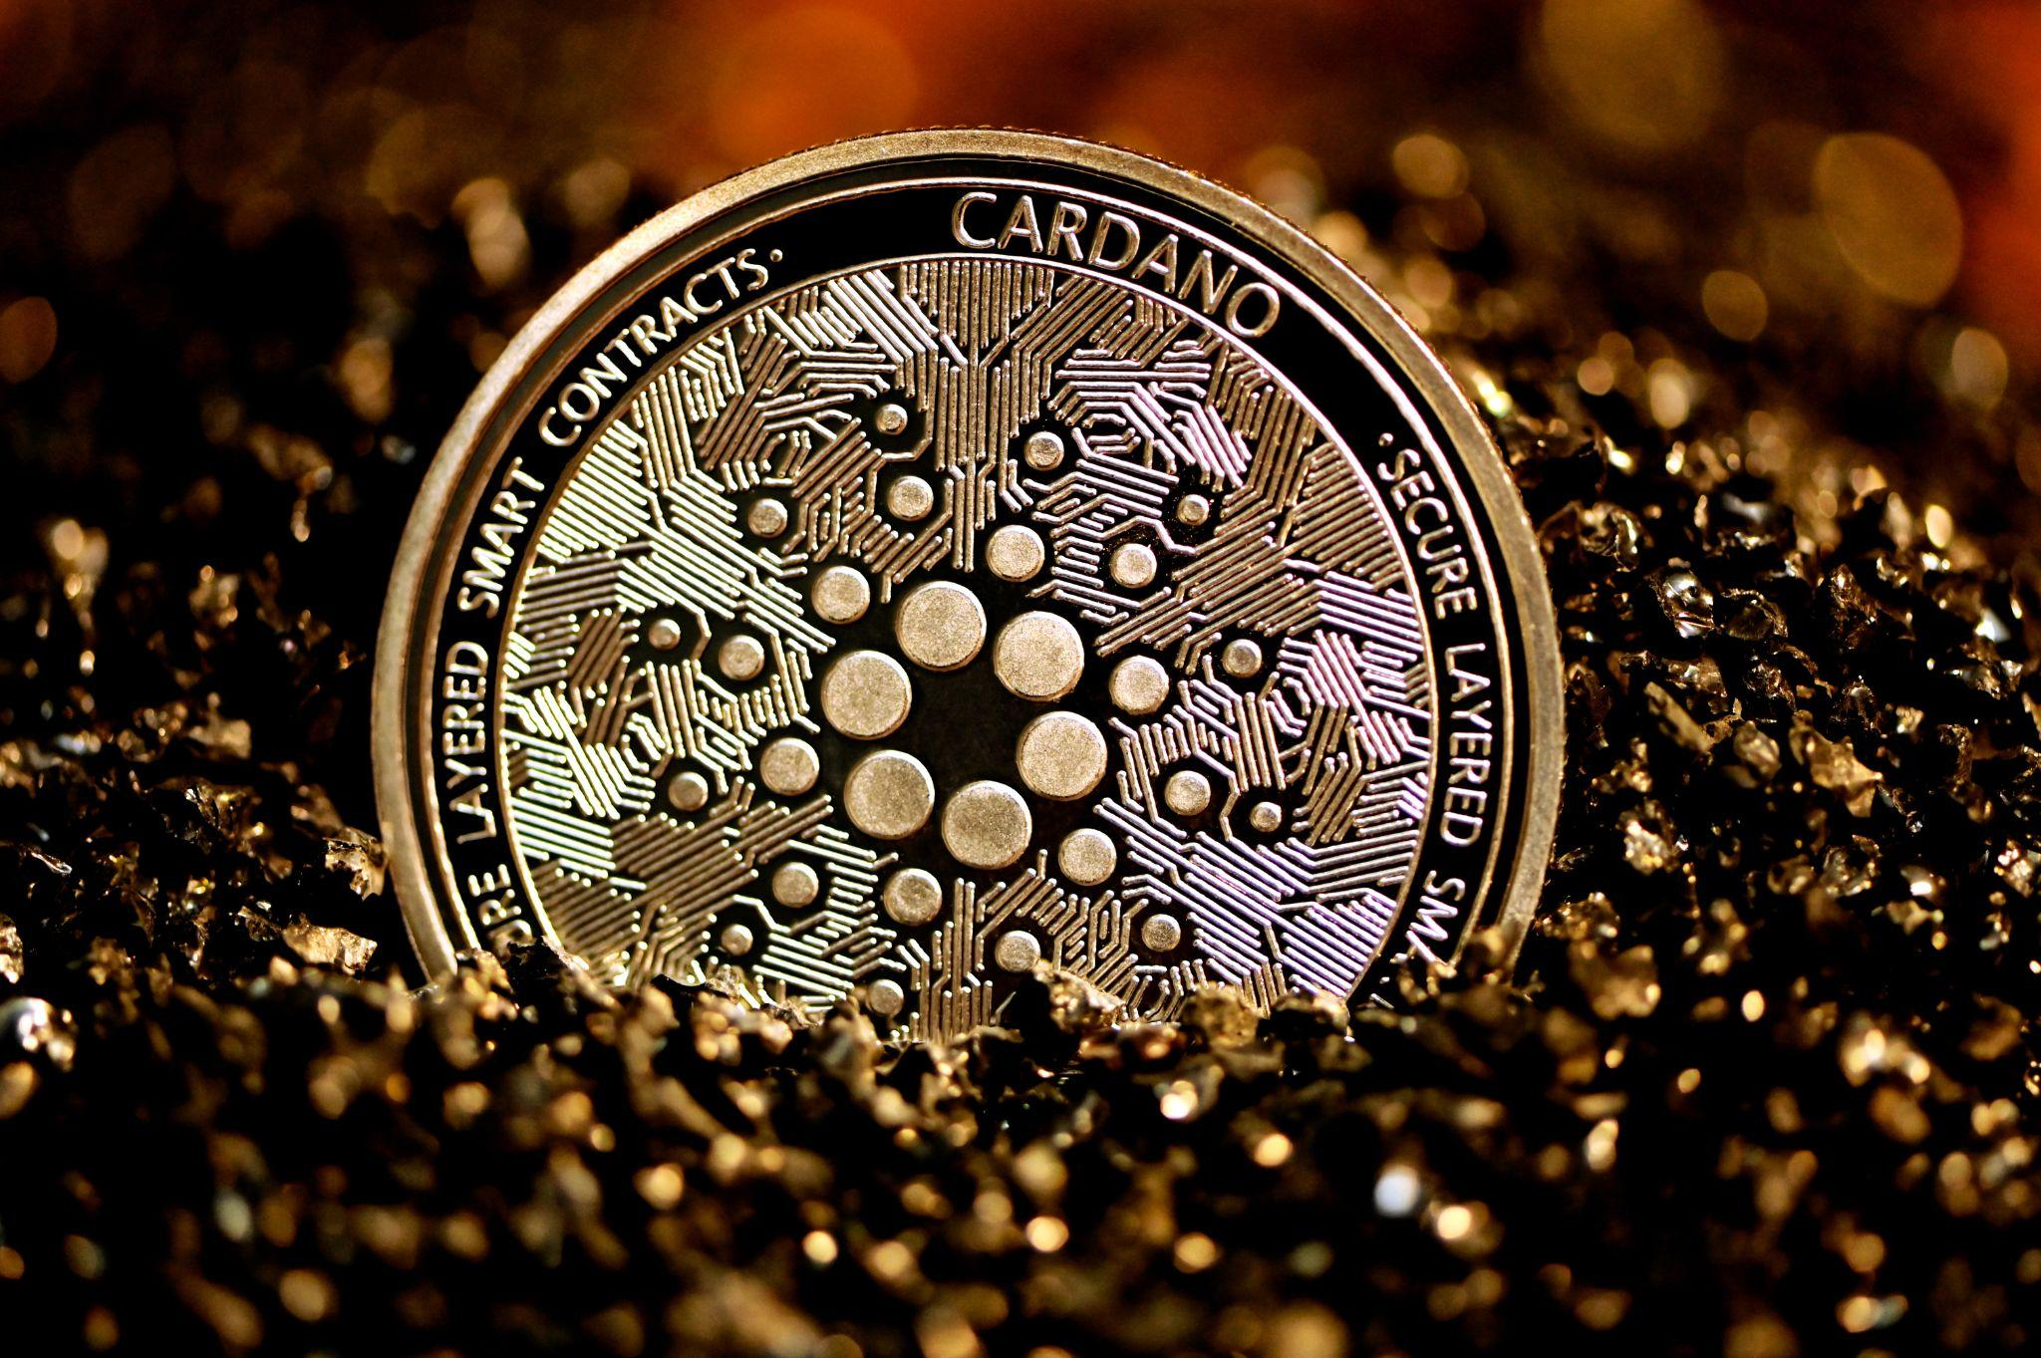
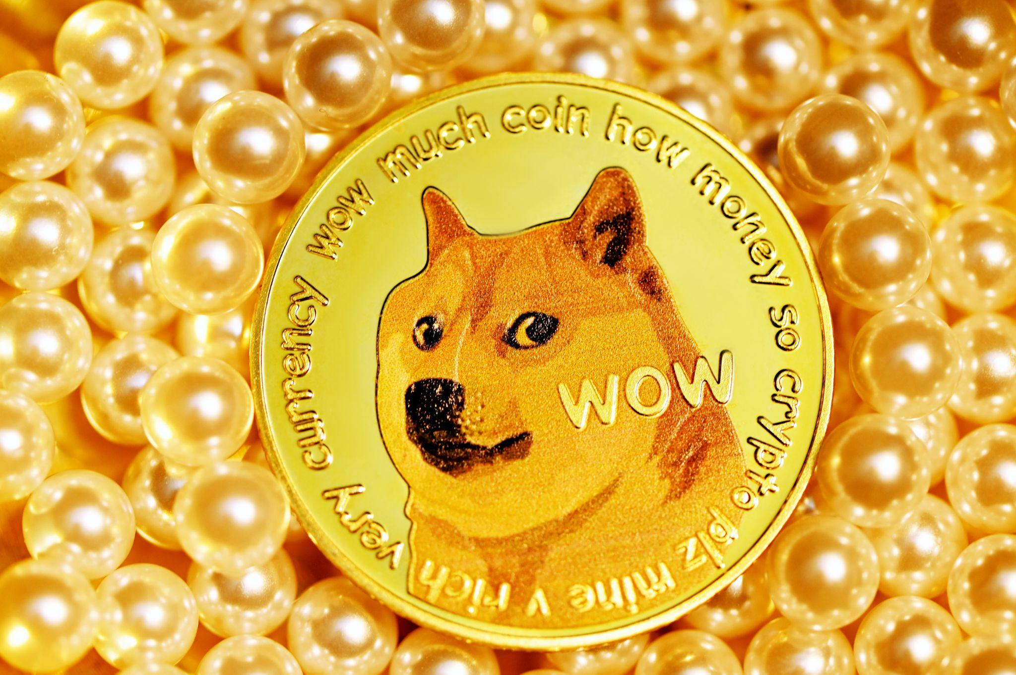
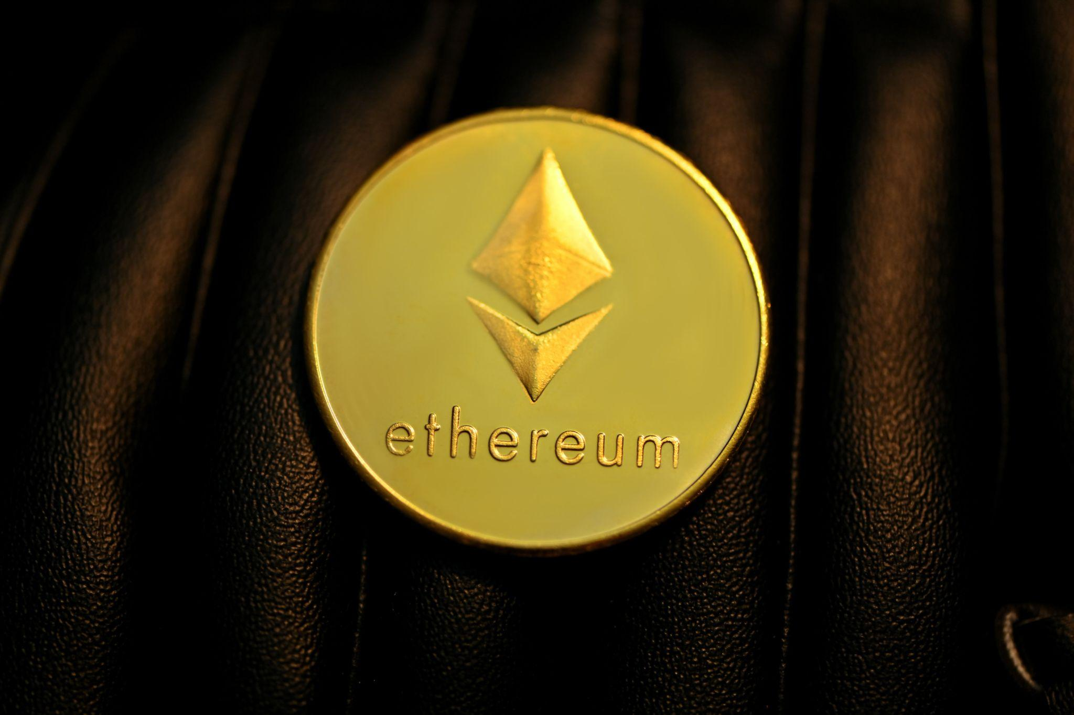

GCB Index
Jan 3, 2021
BTC $32,183
(+77%)
TheGuardian.com
“Bitcoin hits record high on 12th anniversary of its creation”
6 Cryptocurrencies:
Bitcoin
Ethereum
Cardano
Litecoin
Dogecoin
Monero
CNN.com
Dec 27, 2021
BTC $27,039
(+48.8%)
“What the #)$*#@)($ is happening with Bitcoins insane record run?”
Dec 20, 2021
BTC $22,727
(+25%)
SiliconAngle.com
“Bitcoin December rally continues as price breaks $24,000”
News
Paired crypto data with news stories, headlines and general references.
Nov 29, 2020
BTC $18,177
BitCoin.com
“Market Update:Bull Trap Warnings After Bitcoin Shoots Above $18k Handle”
Decrypt.co
“Bitcoin Breaks Past $18,000 As Rally Continues”

Slide 5


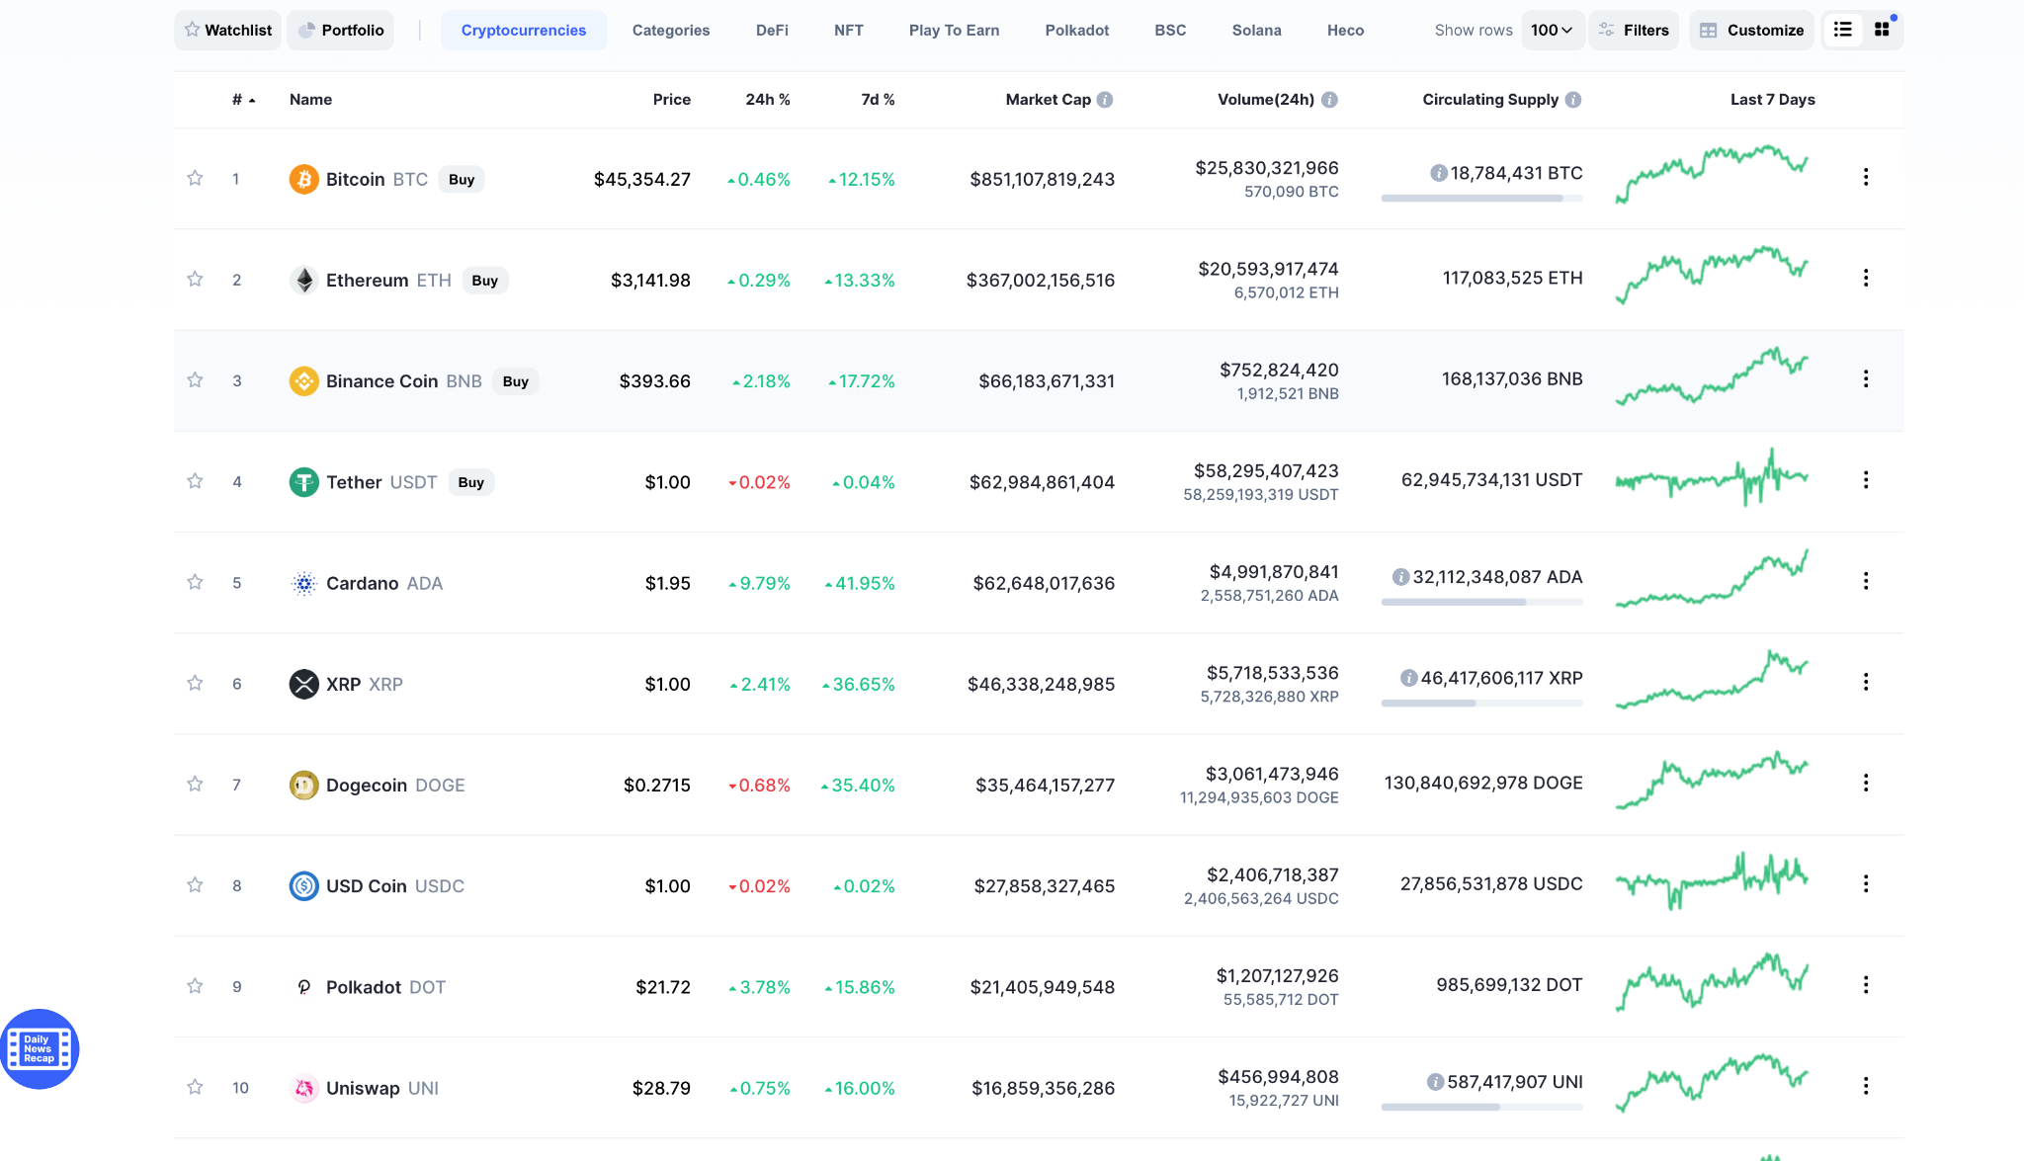
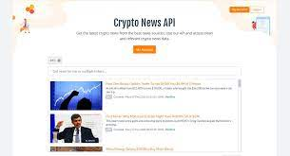
Data Collection

Slide 6
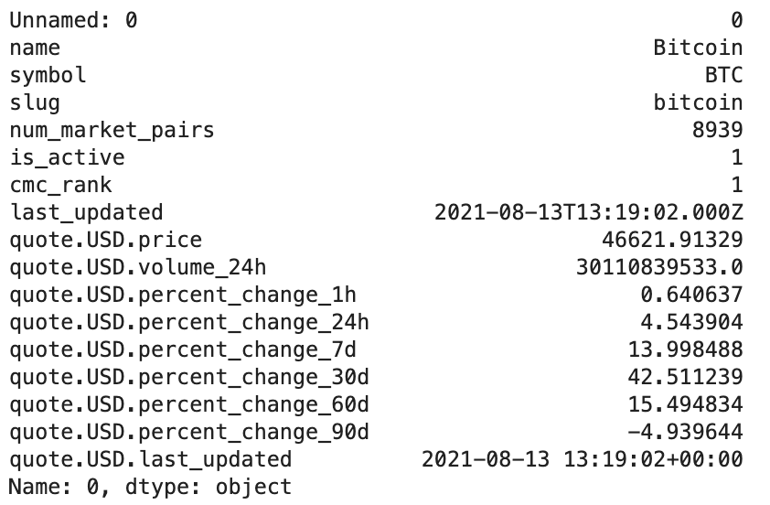
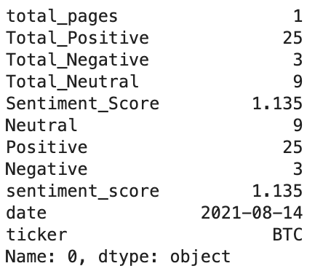
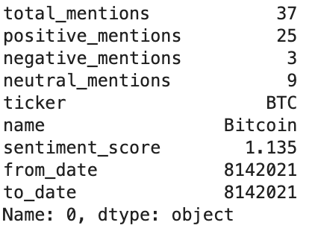
Analysis Process
Latest Quote Data
Ticker Stats
Top Mentions

Slide 7
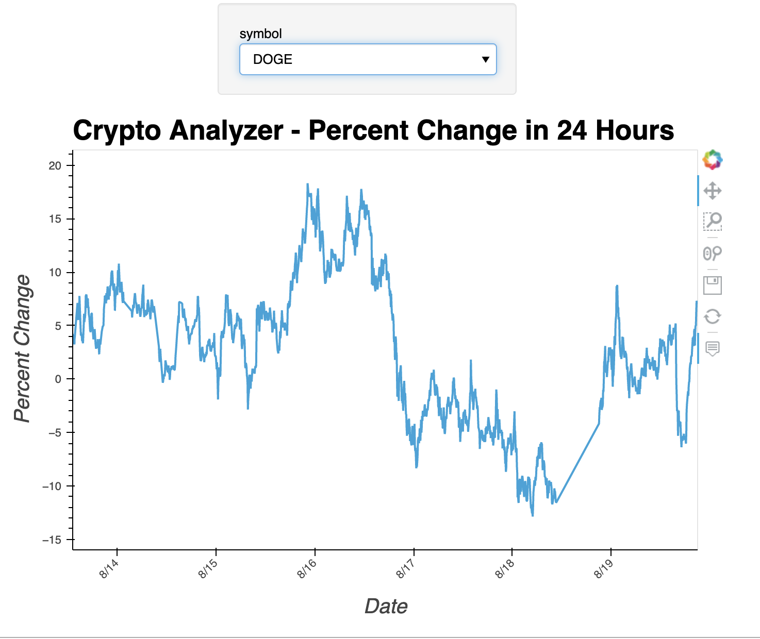
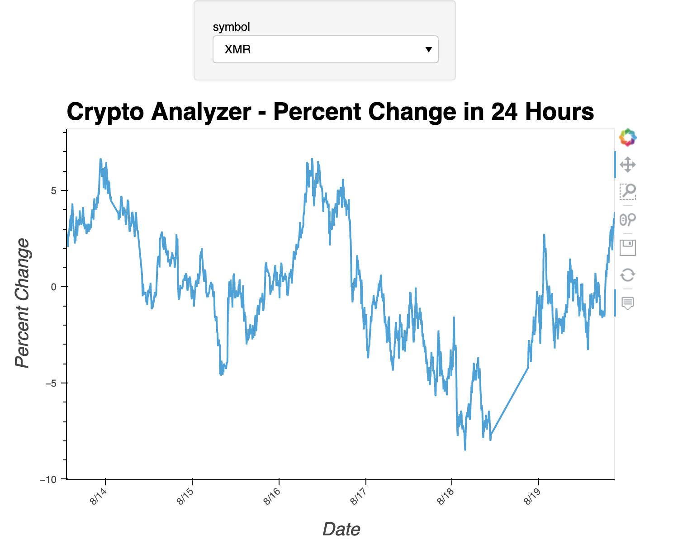
Data Visualization
Percent Change in 24 Hours
(DOGE & XMR)

Slide 8
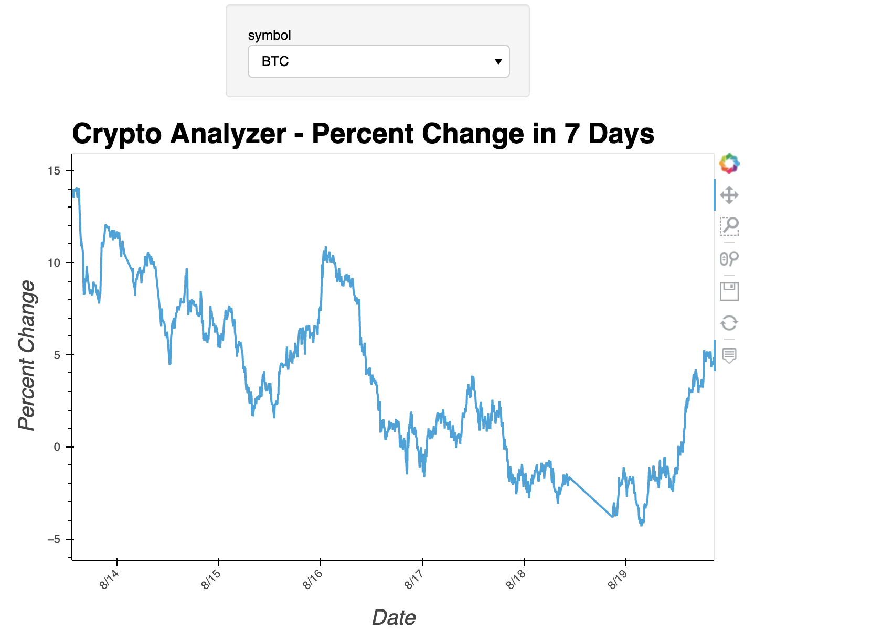
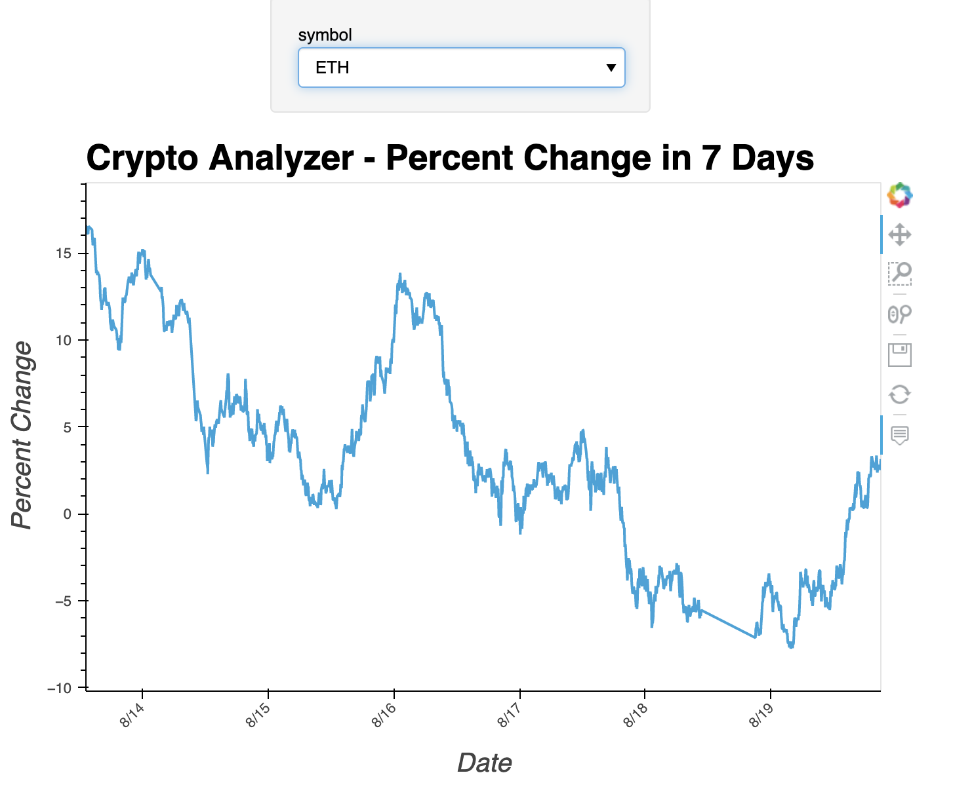
Data Visualization
Percent Change in 7 Days
(BTC & ETH)

Slide 9
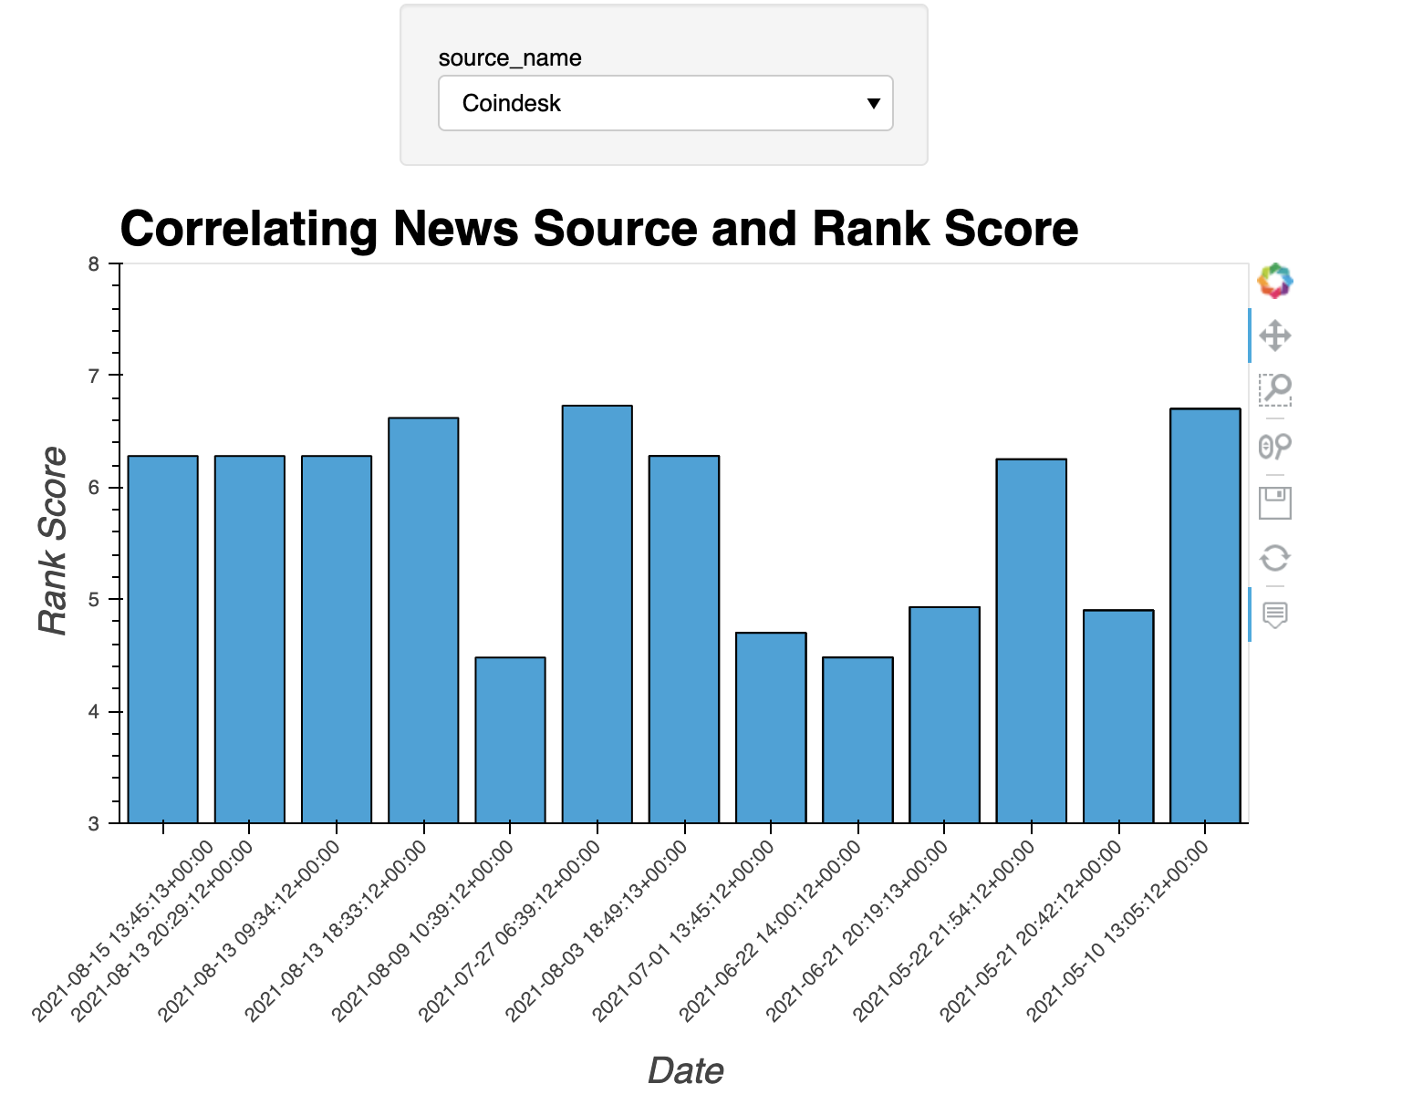
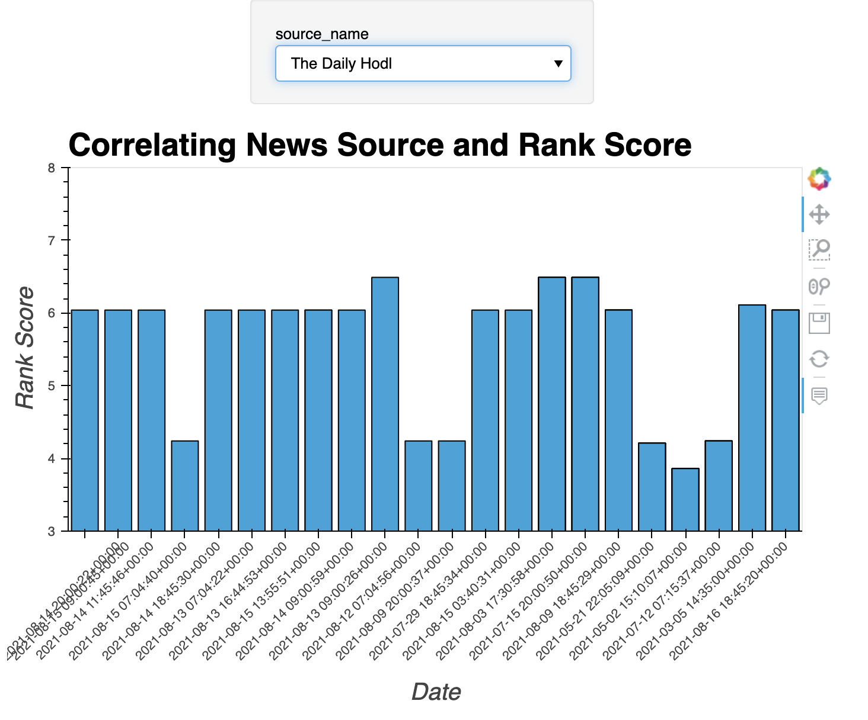
Data Visualization
Correlating News Source and Rank
(Coinbase & The Daily Hodl)

Slide 10
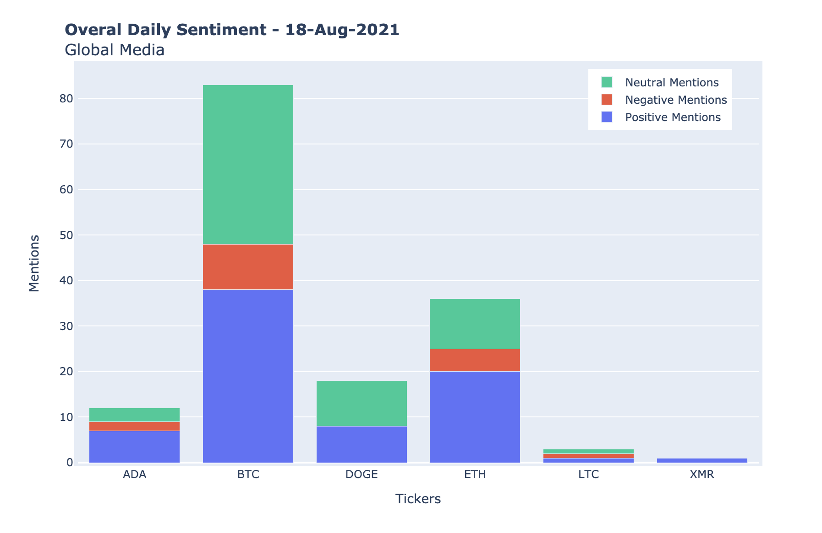
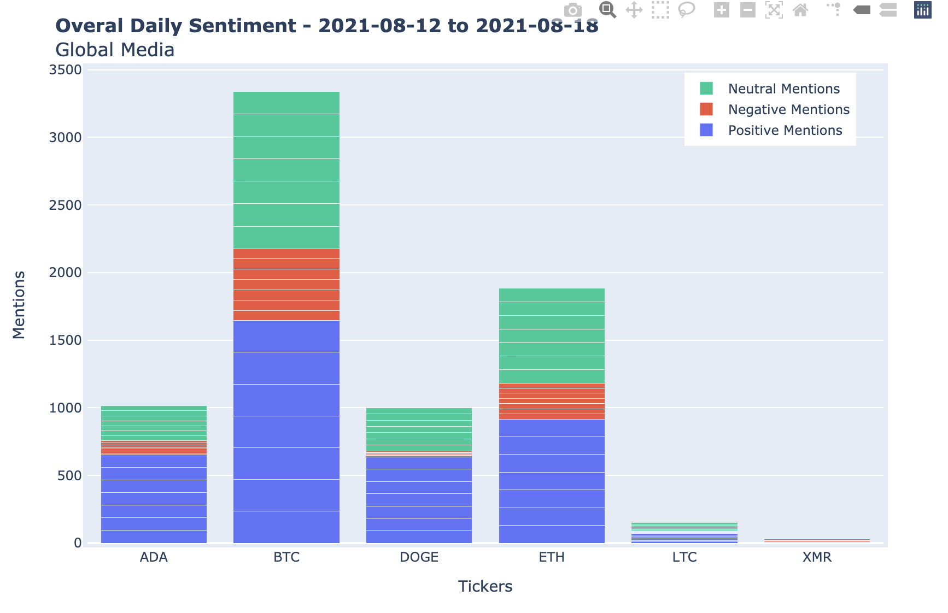
Data Visualization
Overall Daily Sentiment
(Aug 18 2021 & Aug 12-18 2021)

Slide 11

Next Steps
Collect Data
Build upon current data collections/archive.
Integrate social media APIs to introduce trending public perception (e.g., the recent Reddit revolt).
Dashboard Improvements
Improve the interactive dashboard to introduce real time price and volume action for popular cryptocurrencies.
Add Geographic Data
Make plots interactive showing locational data.

Slide 12

Challenges
Time
Set out to create interactive dashboard. Due to time constraints, we were unable to fully build out.
Merging
Bigger picture is for all data sources to be bridged together.
More Data
Collecting enough data to effectively draw conclusions.

Slide 13

Technology
Programming: Python 3.8+
IDE: Jupyter Notebook/Visual Studio
Repository: GitHub
APIs:
CoinMarketCap API
Crypto News API
Libraries
Pandas
Numpy
requests
json
Plotly
hvPlot
panel
Bokeh
Voilà

Slide 14
Images
APIs
Unsplash
https://unsplash.com/license
Coin Market Cap
https://coinmarketcap.com/terms/
“You may only use the Service as expressly permitted by these Terms. All rights not expressly granted to you are reserved by CMC, its third-party providers and other respective owners, if any.”
License
“Unsplash photos are made to be used freely. Our license reflects that.”
All photos can be downloaded and used for free
Commercial and non-commercial purposes
No permission needed (though attribution is appreciated)
Crypto News
https://cryptonews-api.com/termsandconditions
“Welcome to Crypto News API! These Terms of Service (the “Terms”) and our Privacy Policy govern your access to and use of Crypto News API's services and our website.”

